Slide 1
MICROSERVICES
MICROSERVICES VS MONOLITHIC
By Alexander Souza
Notes:
https://www.youtube.com/watch?v=CKL3fV5UR8w
https://www.youtube.com/watch?v=Pvbr5d2mIZs

Slide 2
MONOLITHIC
All these functionalities are grouped within this great system, making it a monolithic application, that is, an application made in a single unit.

Slide 3
MONOLITHIC ARCHITECTURE
Advantages and Disadvantages
User Interface
Advantages and Disadvantages
Business Layer
+ Simple Deploy
- Single Point of Failure
+ Minimizes duplicate code
- Extensive code base
Data Interface
Notes:
Desenhar um telephone para server de exemplo:
Desenhar uma nuvem para o Deploy
Mostrar como quebrar o codigo:
Adicionar mais developers (Dar nomes aos Developers)
Reutilizar codigos (class)
O codigo no Geral fica muito extensso:
Reunioes maiores
Requer um maior conhecimento de todos para evitar grandes falhas
Um simples erro podera comprometer todo o sistema

Slide 4
MICROSERVICES
Is a service that is responsible for one part of the business logic and communicate with each other usually by http.
Notes:
https://www.youtube.com/watch?v=CKL3fV5UR8w

Slide 5
MICROSERVICES ARCHITECTURE
Microservice
User Interface
Microservice
- Independent entities with cross communication through API’s or Message Queuing
Microservice
Microservice
Ref.: https://dzone.com/articles/scalable-cloud-computing-with-microservices
Notes:
Desenhar um telephone para server de exemplo:
Desenhar uma nuvem para o Deploy
Mostrar como quebrar o codigo:
Adicionar mais developers (Dar nomes aos Developers)
Reutilizar codigos (class)
O codigo no Geral fica muito extensso:
Reunioes maiores
Requer um maior conhecimento de todos para evitar grandes falhas
Um simples erro podera comprometer todo o sistema

Slide 6

MICROSERVICES ARCHITECTURE
Invoices
The best team is where
the best leader be
Suppliers
E-commence
Costumers
Products
Ref.: https://dzone.com/articles/scalable-cloud-computing-with-microservices

Slide 7
MICROSERVICES ARCHITECTURE
Advantages and Disadvantages
Advantages and Disadvantages
Invoices
+ Minimize single Point of Failure
- Deploy Complexity
+ Smaller code base
- Maximize duplicate code
Suppliers
E-commence
Costumers
Products
Notes:
Comparar Monolitico com Microservice:
Se algum modulo falhar, nao ira parar todo o systema
Toda a vez que ouver um deploy sera um problema, tera de fazer o deploy de cada microservice
Cada Microservice sera um pequeno Monolitico systema, o codigo sera menor, sera mais facil de rever o codigo ou introduzir um novo membro na equipe.
Caso exista microservicos semelhantes, o codigo tera de ser duplicado, cada unidade funcionara de forma independente.

Slide 8
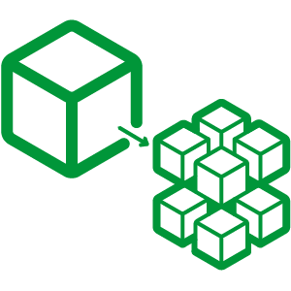
CONCLUSION
Microservice vs Monolithic
Microservice
Monolithic
If application is really big, complex, and does a lot of different things.
In case of a simple application, monolithic architecture is a better approach.
Notes:
Microservice
Programas escalavel
Ligar a aplicacao ao Website
Ligar ao supplier
Ligar ao customers
Reliable
Apenas parte do service ficara indisponivel
Facil de restaurar o service
Monolithic
Aplicacoes Simples
Nao escalavel
Mobile app

Slide 9
MICROSERVICES
Programming languages ?
Containers ?
Container platform ?
Notes:
https://www.slideshare.net/shaunabram/an-intro-to-rest-and-microservices

Slide 10
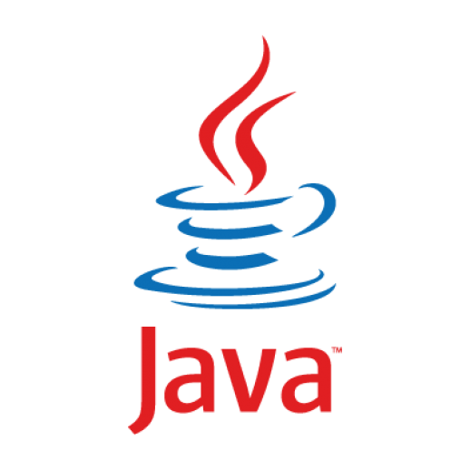
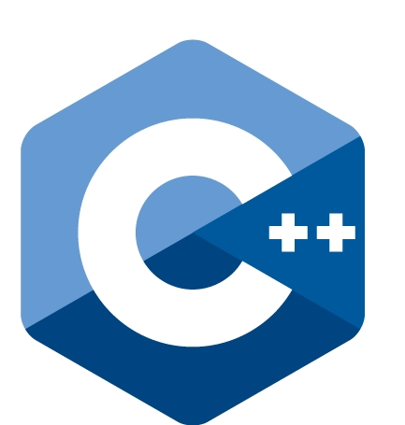
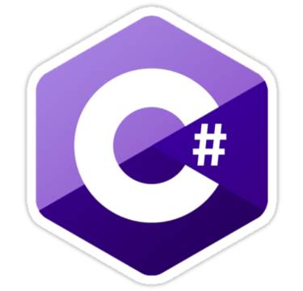


The most popular programming languages for services and microservices are.
Notes:
The best back-end languages will probably be Java, C#, C or C++ because these languages are highly structured and efficient in execution and resources and have extensive libraries of business tools available.
Services written in C or C++ are highly efficient in resource use and high in performance.
Difficulty obtaining C or C++ skills locally, you may want to think more of Java or C#.

Slide 11
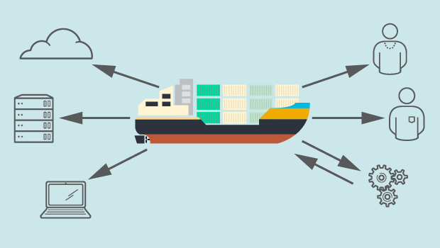
WHAT ARE CONTAINERS?
Containers encapsulate discrete components of application logic provisioned only with the minimal resources needed to do their job.
Notes:
40% Cloud use containers
Exemplos:
Instalar aplicacoe em nosso computadores devemos ter o Sistema operative que consome muita memoria.
Instalar packegs
Plugins
Consome tempo recurso tempo.
As vezes com tudo instalado ainda nao funciona.
Containers
Cria-se somento a configuracoes nescesaria para o funcionamento da aplicacao.
Maior redundancia
Melhor desempenho.
Redus o tempo de instalacao

Slide 12

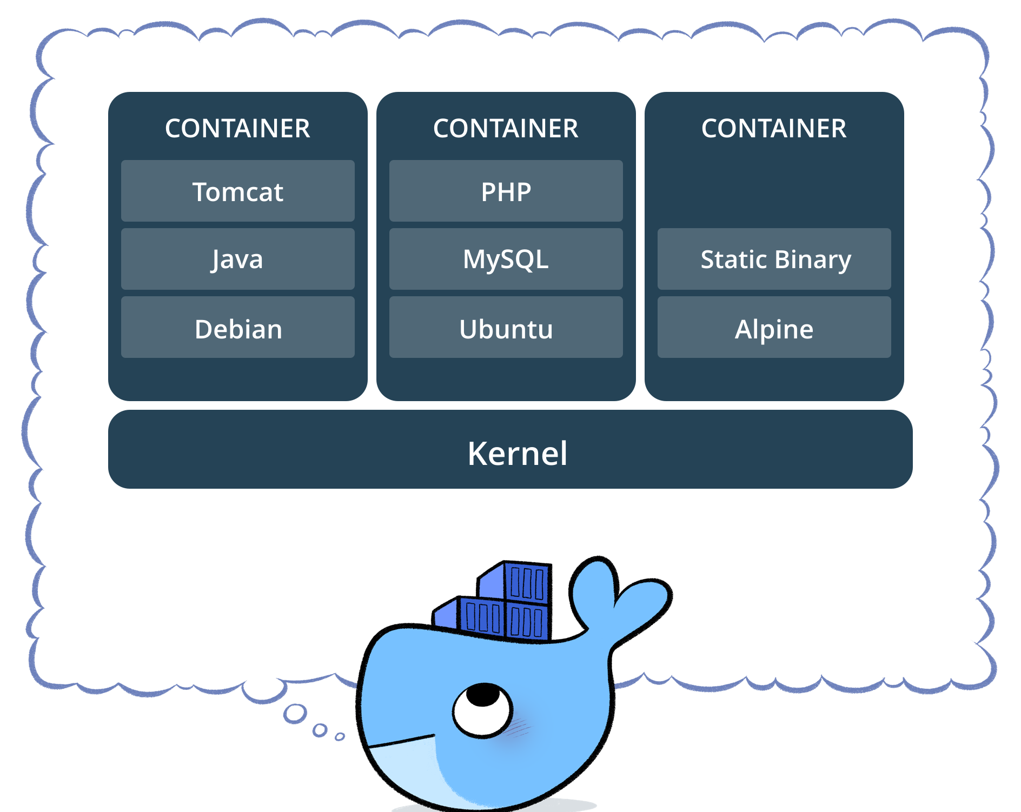
Lightweight, stand-alone, executable package of software to run specific services.
Package includes code, runtime, system libraries, configurations, etc.
Notes:
Bom link de implementacao
https://www.slideshare.net/BlueDataInc/best-practices-for-running-kafka-on-docker-containers

Slide 13
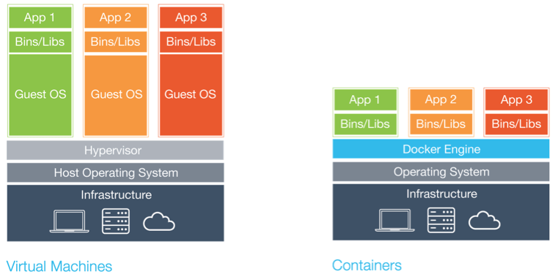
docker

Slide 14
docker
Advantages
Scalability
Flexibility
Portability
Simplicity
Return on investment & cost savings
Standardization & productivity
CI efficiency
Compatibility & maintainability
Simplicity & faster configurations
Rapid Deployment
Continuous Deployment & Testing
Multi-Cloud Platforms
Isolation
Security

Slide 15
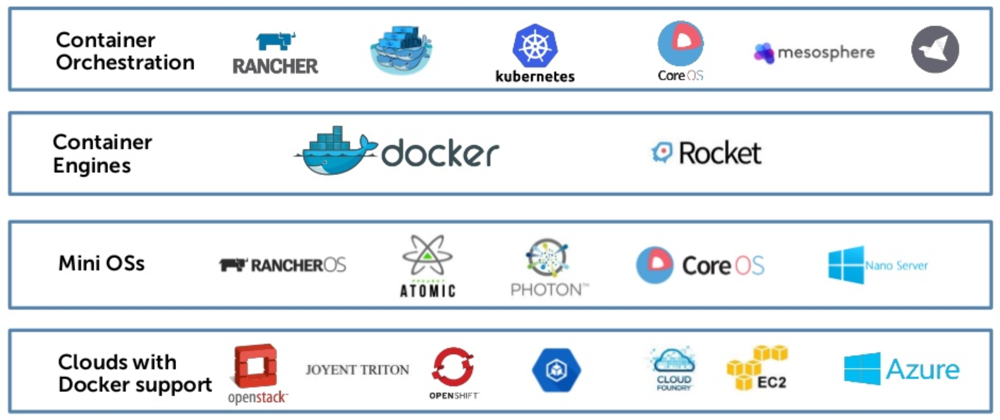
The following list contains the differentiating container platform feature
Notes:
https://www.slideshare.net/barton808/devops-microservices-and-containers-a-high-level-overview

Slide 16
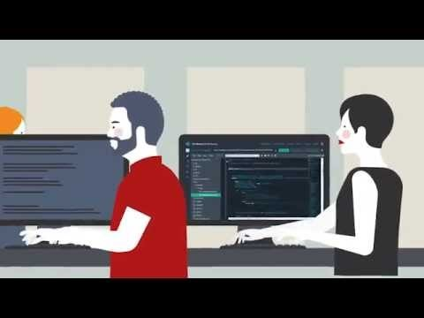
Notes:
https://www.youtube.com/watch?v=Pvbr5d2mIZs
Tempo 1:28

Slide 17
Recap

Slide 18

Thanks ☺

